Slide 1
4
6
0
2
0
1
1
5
4
7
3
3
2
data # | Dot | Line | hist | …
0 | Update 0 | Update 0
1 | Update 1 | Update 1, 2
2 | Update 2 | Update 3
3 | Update 3 | Update 4
4 | Update 4 | Update 0
5 | Update 5 | Update 1
6 | Update 6 | Update 2
7 | Update 7 | Update 3, 4

Slide 2
4
6
0
2
0
1
1
5
4
7
3
3
2
Dot | Line | hist | …
Update func | Update func

Slide 3
Web browser
Data generation
(data.js)
R

Slide 4
mainArr
drawing line
calc
axis
axis
axis
axis
line

Slide 5
D
 | 0 | 1 | 2 | 3 | 4
0 | 1
1
2
3
4
5
6
7
L
3
0
0
1
5
1
2
7
4
3
4
6

Slide 6
3
L
 | 0 | 1 | 2 | 3 | 4
0 | 1 | 0 | 0 | 0 | 0
1 | 0 | 1 | 1 | 0 | 0
2 | 0 | 0 | 0 | 0 | 0
3 | 1 | 1 | 0 | 0 | 0
4 | 0 | 0 | 0 | 1 | 0
5 | 0 | 0 | 1 | 0 | 1
6 | 0 | 0 | 0 | 0 | 1
7 | 0 | 0 | 0 | 1 | 0
D
0
5
1
7
4
6
0
1
2
4
3

Slide 7
 | 0 | 1 | 2 | 3 | 4
0 | 1 | 0 | 0 | 0 | 0
1 | 0 | 1 | 1 | 0 | 0
2 | 0 | 0 | 0 | 0 | 0
3 | 1 | 1 | 0 | 0 | 0
4 | 0 | 0 | 0 | 1 | 0
5 | 0 | 0 | 1 | 0 | 1
6 | 0 | 0 | 0 | 0 | 1
7 | 0 | 0 | 0 | 1 | 0
Dot update
Line update
1 | 0 | 0 | 0 | 0 | 1 | 0 | 1
1 | 0 | 1 | 1 | 1
(1: selected, 0: unselected)
<Relationship Array>

Slide 8
Dot update
Histogram Update
p nodes
 | 0 | 1 | 2 | … | n-1
0 | 1 | 0 | 0 | … | 0
1 | 0 | 1 | 1 | … | 0
2 | 0 | 0 | 0 | … | 0
3 | 1 | 1 | 0 | … | 0
4 | 0 | 0 | 0 | … | 0
︙ | ︙ | ︙ | ︙ | ︙ | ︙
p-1 | 0 | 0 | 0 | … | 0
n nodes
1 | 0 | 0 | 0 | 0 | 〮〮〮 | 1
1 | 0 | 1 | 〮〮〮 | 1
isSelected for dot graph
isSelected for histogram graph
<Relationship Array>

Slide 9
Theoph
dot
Axis1
R
histObj1
loffObj1
line
Axis2
bar
: Data Object
: Graph Object
: Axis Object

Slide 10
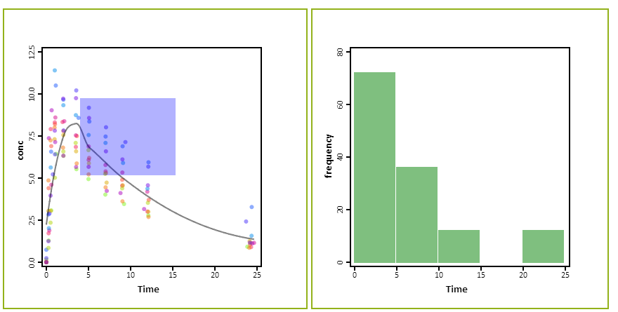

Slide 11
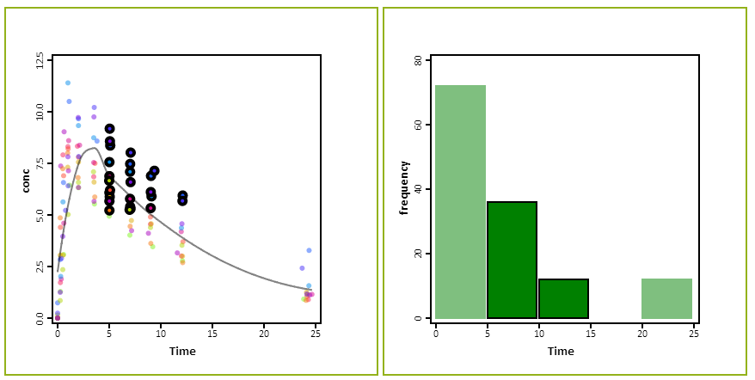

Slide 12
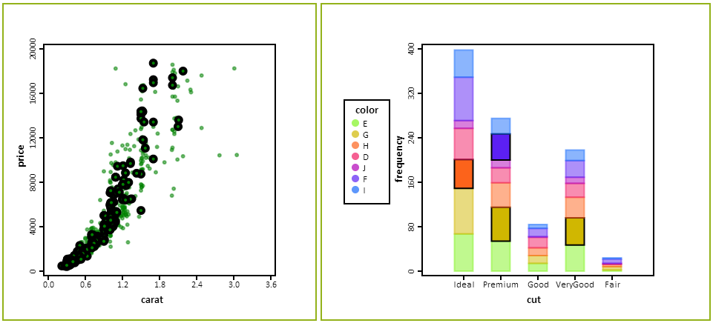

Slide 13
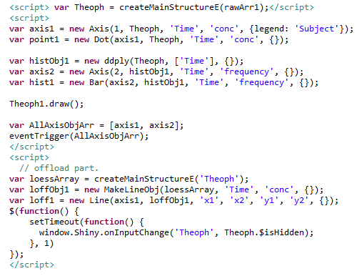

Slide 14
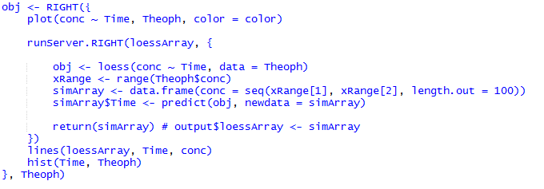

Slide 15


Slide 16
 | 0 | 1 | 2 | … | p-1
0 | 1 | 0 | 0 | … | 0
1 | 0 | 1 | 1 | … | 0
2 | 0 | 0 | 0 | … | 0
3 | 1 | 1 | 0 | … | 0
4 | 0 | 0 | 0 | … | 0
5 | 0 | 0 | 1 | … | 1
︙ | ︙ | ︙ | ︙ |  | ︙
n-1 | 0 | 0 | 0 | … | 0

Slide 17
Obj <- RIGHT({
plot(conc ~Time, Theoph, color = color)
runServer.RIGHT(loessArray, {
obj <- loess(conc ~ Time, data = Theoph)
xRange <- range(Theoph$conc)
simArray <- data.frame(conc = seq(xRange[1], xRange[2], length.out = 100))
simArray$Time <- predict(obj, newdata = simArray)
return(simArray)
})
lines(loessArray, Time, conc)
hist(Time, Theoph)
}, Theoph)

Slide 18
<script> var Theoph = createMainStructureE(rawArr1);</script>
<script>
var axis1 = new Axis(1, Theoph, 'Time', 'conc', {legend: 'Subject'});
var point1 = new Dot(axis1, Theoph, 'Time', 'conc', {});
var histObj1 = new ddply(Theoph, ['Time'], {});
var axis2 = new Axis(2, histObj1, 'Time', 'frequency', {});
var hist1 = new Bar(axis2, histObj1, 'Time', 'frequency', {});
Theoph1.draw();
var AllAxisObjArr = [axis1, axis2];
eventTrigger(AllAxisObjArr);
</script>
<script>
// offload part.
var loessArray = createMainStructureE('Theoph');
var loffObj1 = new MakeLineObj(loessArray, 'Time', 'conc', {});
var loff1 = new Line(axis1, loffObj1, 'x1', 'x2', 'y1', 'y2', {});
$(function() {
setTimeout(function() {
window.Shiny.onInputChange('Theoph', Theoph.$isHidden);
}, 1)
});
</script>

